Slide 1

MEDICARE
Business Requirements
Document
Healthcare Operations & Revenue Analytics | SQL/MySQL
BRD-focused presentation • Version 1.0
MEDICARE • HEALTHCARE OPERATIONS & REVENUE ANALYTICS 1

Slide 2
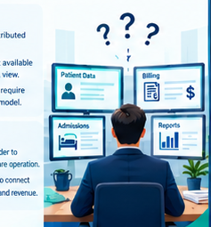
1. Business Problem & Core Question
Why the analytics model is required
How effectively is MediCare managing healthcare operations and converting delivered services into collected revenue?
• Healthcare information is distributed across multiple entities.
• Operational information is not available through one consolidated SQL view.
• The model connects healthcare demand, clinic/specialist operations, billing and payments.
MEDICARE • HEALTHCARE OPERATIONS & REVENUE ANALYTICS 2

Slide 3
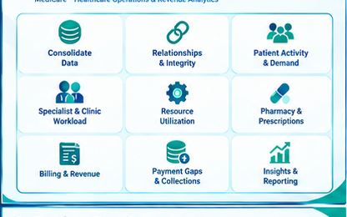
2. Business Objectives & Data Scope
What the SQL solution must support
• Consolidate healthcare operational data.
• Enable SQL-based operational analysis.
• Analyze member and consultation activity.
• Understand specialist and clinic workload.
• Measure billing, revenue and payment performance.
• Identify data-quality and relationship exceptions.
Core entities: Members • Clinics • Specialists • Consultations • Labs • Claims • Billing • Payments
MEDICARE • HEALTHCARE OPERATIONS & REVENUE ANALYTICS 3

Slide 4
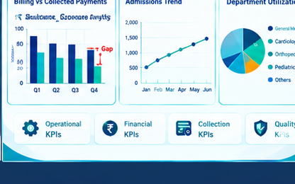
3. Key Analytics & KPIs
Business questions translated into measurable SQL outputs
• Members: total members, membership-type and gender distribution, members by city.
• Operations: consultations by mode/status, high-volume specializations and top 5 clinics.
• Revenue: total revenue, average bill value and consultation/lab/medicine contribution.
• Specialists: consultation-fee ranking overall and within specialization.
• KPIs: Total Revenue and Total Number of Specialists.
MEDICARE • HEALTHCARE OPERATIONS & REVENUE ANALYTICS 4

Slide 5

4. Revenue, Collection & Operational Insight
How management can use the analytical outputs
• Measure total billed revenue and average bill value.
• Separate consultation, laboratory and medicine charge components.
• Track payment outcomes: successful, failed and refunded.
• Identify collection gaps and payment follow-up areas.
• Analyze consultation demand, clinic workload and specialist activity.
• Maintain the correct billing/payment grain to avoid double counting.
MEDICARE • HEALTHCARE OPERATIONS & REVENUE ANALYTICS 5

Slide 6
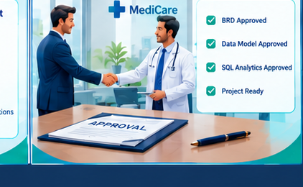
5. Data Quality, Governance & Outcome
Validate the data before publishing management KPIs
• Profile inconsistent gender values and standardize where applicable.
• Find blank or invalid member emails.
• Identify claims/billing records without consultation relationships.
• Check missing insurance-provider and payment-mode information.
• Validate financial values and relationships before KPI reporting.
• Outcome: connected operational visibility with controlled revenue and collection analytics.
MEDICARE • HEALTHCARE OPERATIONS & REVENUE ANALYTICS 6

